Slide 1
TARGETED
E-DEPLOYMENT
CBS E-MARKETING

Slide 2
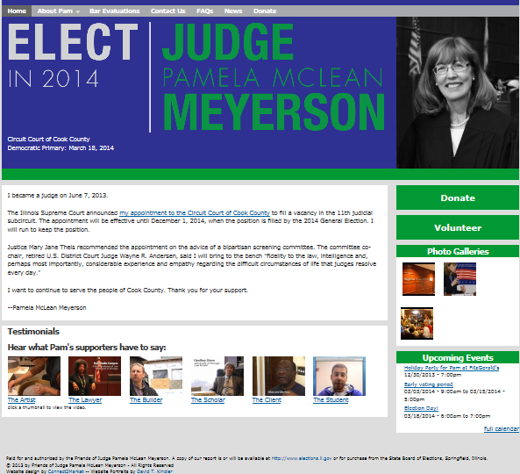
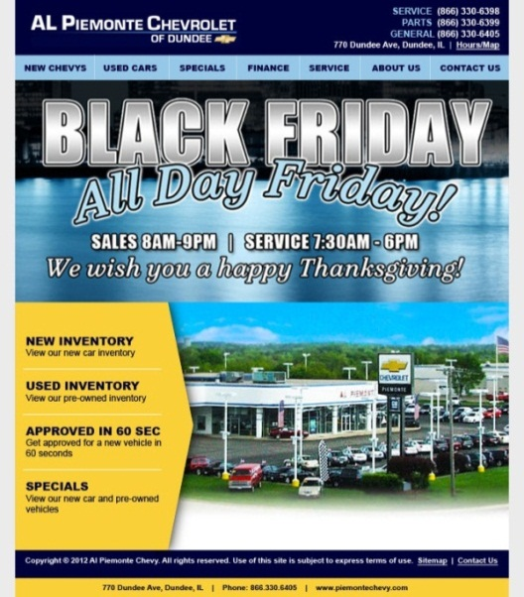
CBS TARGETED
EMAIL DEPLOYMENT CAMPAIGNS
WHAT THIS PROGRAM IS:
Targeted email ads sent to individuals who have opted-in to receive advertising messages.

Slide 3
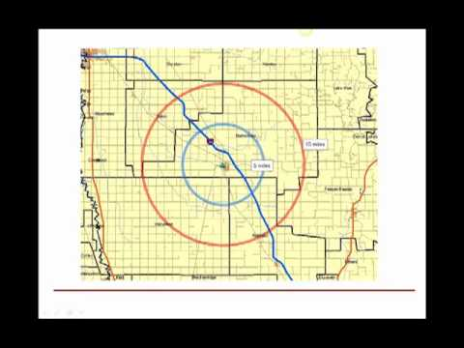
GEO-TARGETING
FROM NATIONAL TO LOCAL T0 DISTRICT TO ZIP CODE
ACCESS TO MILLIONS OF CONSUMERS
The list is compiled from self-reported consumers and businesses that have opted-in their information via online surveys, e-subscriptions, and e-registrations, as well as from an extensive network of permission based websites and partners.
THE LIST IS COMPRISED OF:
5,000,000 in the Chicago DMA
8,000,000 in Illinois
60,000,000 in the top ten DMA’s
225,000,000 in the U.S.*
Nationwide, State, DMA MSA, County, City, Zip code
Custom Geography
Judicial, Legislative, State or
Broadcast Area

Slide 4
HOW WE TARGET THE LIST
Advertisers may target the list not only geographically but also by demographics, interests, behaviors and even to businesses.
Consumer Interests and Demographics
Age
Gender
Ethnicity
Occupation
Education
Language
Marital Status
Household Income
Net Worth
Golfers, Pet Owners
Homeowner/Renter
Home Market Value
Dwelling Type
Presence of Children
Interest in Purchasing an Auto
Business to Business:
Select from 18,000 SIC’s (Standard Industry Codes)
Choose from 300 + Titles, including C level executives, owners
Select by Annual Revenue
Select by number of employees

Slide 5
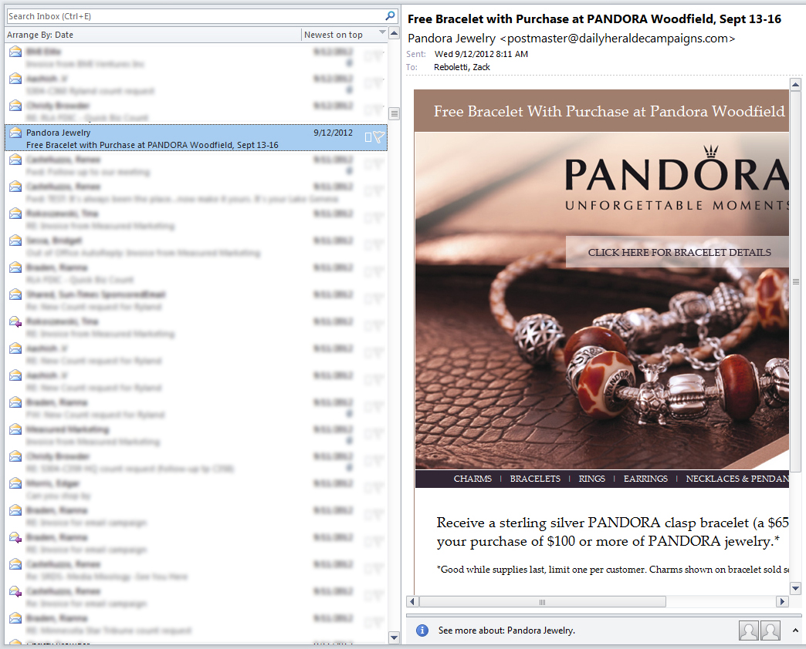
COMPONETS OF THE E-MARKETING DEPLOYMENT
EMAIL AD COMPONENTS
From Name
Subject Line
From Address
Preview Text
Unsubscribe
Click here to unsubscribe
Compliance Department – 118 S. Clinton, Suite 760, Chicago, IL 60661
TheDailyPlanet.com

Slide 6
COMPREHENSIVE BACK-END REPORTING
Deployment Date | Delivered | Opens | % Opens | Clicks | % Clicks | Clicks-to-Opens | Unsubscribes
1/31/13 | 46,837 | 4,193 | 8.95% | 764 | 1.63% | 18.22% | 10
Report & Measure Clicks by Specific Link
Blog Text Link – Link to Blog Page | 8
Contact Us Text Link – Link to Contact Page | 28
Company Logo – Link to Main Page | 47
Navigation Bar – Link to Change Moments Page | 127
Navigation Bar – Link to Traditional Services Page | 14
Navigation Bar – Link to Specialized Services Page | 46
Navigation Bar – Link to Industries Page | 13
Navigation Bar – Link to Our Firm Page | 84
Navigation Bar – Link to Tools and Apps Page | 11
Navigation Bar – Link to Articles Page | 86
Image, Download Text Link & Download Button – Link to PDF Page | 195
Image – Link to PDF Page | 14
Learn More Text Link – Link to Main Page | 59
Company Name Text Link – Link to Main Page | 7
Website Text Link – Link to Main Page | 15
Unsubscribe | 10
TOTAL | 764
VERTICAL: Banking and Financial Services
OBJECTIVE: Brand Awareness and Lead Generation
TARGETING: Business Owners, C-Level Executives, Controllers within a 20 mile radius around location zip
Subject: 18 Ways to Cut Your Taxes
Notes:
Banking and Financial Services (5579-1)

Slide 7
HOW WE MEASURE PERFORMANCE
Open rates average from 7% to 9%.
The national average for opens on prospecting email is 3%.
Advertiser repeat rate is over 80%.
Real-time tracking provides internal QC checks throughout deployment and guarantees timely delivery.
Deployment Date | Delivered | Opens | % Opens | Clicks | % Clicks | Clicks-to-Opens | Unsubscribes
12/12/12 | 209,000 | 19,416 | 9.29% | 3,771 | 1.80% | 19.42% | 53
Delivery details are automatically provided 72 hours following deployment. Ads will be re-deployed if the open rate is less than 3%.

Slide 8
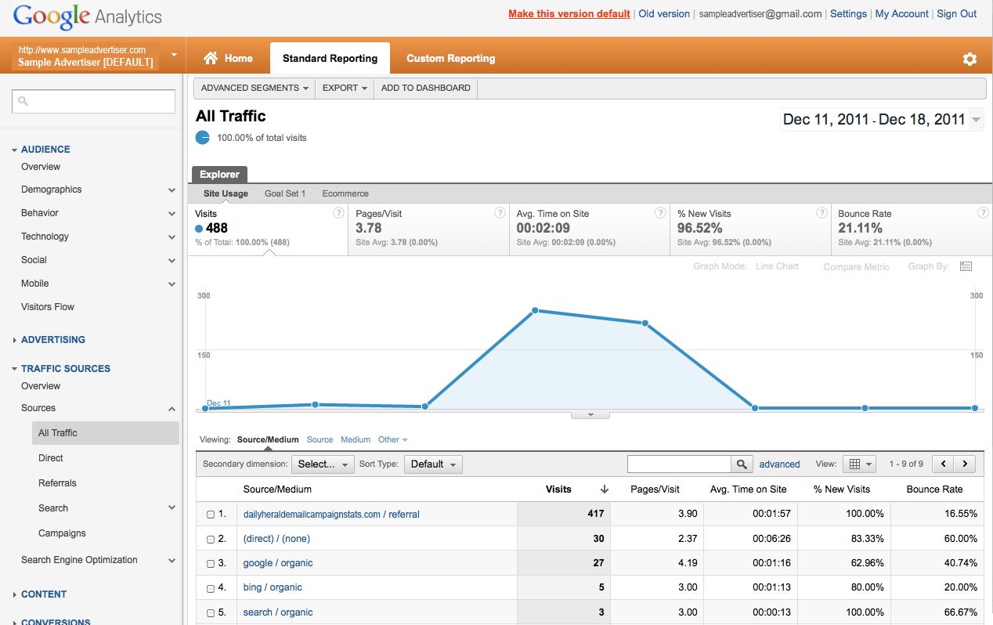
SEE THE RESULTS AND IDENTIFY THE SOURCE
cbs_ecampaigns.com / referral

Slide 9
SAMPLE INTEGRATION
JUDGE OLIVER HOLMES
JUDGE HOLMES OBJECTVES:
To increase awareness of JUDGE HOLMES record.
Utilize :60 on-air & on-line commercials for messaging.
Live Search Directors to have voters search specifically JUDGE HOLMES.
Local Search will help JUDGE HOLMES be not only found, but selected, when voters search for judicial candidates on the internet.
Drive voters to early voting .
Dedicate a portion of your :60 on-air & on-line spot to early GOTV
Deploy an email blast to specific party and independent voters in your district.
Promote JUDGE HOLMES .
Use Rotating 300x250 banners on CBSChicago.com featuring your endorsements.
Use an on-line circular ad to showcase testimonials .
Deploy an email blast to voters in specific zip codes.

Slide 10
SAMPLE INTEGRATION
JUDGE O. HOLMES
Your monthly advertising campaign on CBS will include:
On- Air:
25x M-F 5A-7P
15x M-F 5A-12M
6x Sa-Su 7A-7P
On-Line Streaming Listening:
80x commercials on CBSChicago.com
On-Line:
250,0000 300x250 Rotating banners for featured products and sales
250,000 On-Line circular for items currently in stock or on sale
Email Deployment:
1x email deployment to 100,000 consumers within a ten mile radius of your Niles store
1x email deployment to 200,000 female consumers in the Chicago DMA
Search:
20x Live, on air search directors (5x per week)
“When searching for quality flooring , search Floor & Décor”
500 connections on CBS Local Search

Slide 11
CBS E-MARKETING AE FAQ’S
Q: Is there a minimum order?
Yes. The minimum order is 75,000 circulation or $2250.
Q: What is the average circulation for an email deployment ?
Between 75,000 and 100,000.
Q: What does the fee include?
The base rate of $30.00 per thousand includes the list, geo targeting , creative, HTML programming, quality list, deployment and back-end reporting. Each additional qualifier (target) adds incremental dollars to the base rate.
Q: How specific can I get with my qualifiers?
Best practices show that adding no more than 1-2 additional qualifiers will achieve best results for the Advertiser. (Example: gender, age, or income – NOT all three)
Q: How quickly can we turn around an order?
Once paperwork is submitted, plan of 4-5 business days.
Q: How quickly will I get results?
Back end reports are provided 72 hours following deployment.
Q: Can I get a mock up to show my client?
See manager for approval. Your best practice is to use your client’s home page as an example.
Q: How will this be written up?
Your orders will be written up as digital. However, there are hard costs that will be orbited out. When it comes time to write up your first order, please see Kristen.
Q: What is the best part about this program?
There is NO BUDGET OR BUCKET FOR THIS PROGRAM! It’s purely an opportunity for you as sellers to better serve your clients and make additional dollars!

Slide 13
HOW IS CBS E-MARKETING DIFFERENT?
 | CBS E-MARKETING | CONSTANT CONTACT & IN HOUSE LIST OF CUSTOMERS | PURCHASED LISTS | MEDIA EBLASTS (NEWSPAPER, RADIO, TV)
WHAT IT IS: | Database and deployment system of qualified prospects that you do not currently have in your database. Sometimes referred to as “Acquisition” or “Prospecting” emails. | Deployment product used to communicate to your in house customer database. | Database of new email addresses your company currently does not have access to. | Database of loyal participants that have “opted-in” to receive updates & information from the specific media outlet.
WHO MANAGES: | CBS manages start to finish. Pricing includes highly targeted list with available qualifying criteria, creative & artwork, html, testing, deployment, and back end reporting. | Product helps you manage deployments. | You will need to utilize a deployment system. Some systems like Constant Contact will not allow the upload of purchased lists. | Media Outlet
ABILITY TO REACH NEW LEADS: | YES | NO | YES | YES
QUALITY OF LIST ENSURED: | YES | NO | NO | NO
APPROX COST: | $30 CPM | Monthly Fee | Monthly Fee | $50-100 CPM
PRO: | Highest quality of lists, with strong ISP reputation. Lists are scrubbed daily to ensure names and preferences are correct and current. Consumer lists come from credible sources and have been verified as “opt in”. Turn key program execution with results & reporting in as little as 72 hours. | Helps you manage the communication process. | Can purchase them relatively cheaply. | Good to promote station involvement and media related events.
CON: |  | Does not provide you with an acquisition database. | Quality, integrity and targetability and of lists are questionable. Unknown factors include: How old are the lists? Were the names acquired legally? Still need a deployment system. | Lists are relatively small and often times you are limited to the placement, size and content of your message.

