Slide 1
CBS RADIO CHICAGO
POLITICAL RATES
11/11/2013

Slide 4
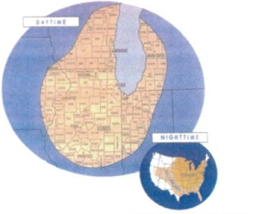
WBBM NEWSRADIO CBS CHICAGO
2014 POLITICAL RATES
Who is the Newsradio Listener?
1.4 Million people listen to WBBM Newsradio each week…
Our Audience, Your Consumer!
WELL EDUCATED
69% have attended college
WHITE COLLAR
49% or 230,00 are employed full time
40% or186,000 are white collar
HIGH INCOME
26% or 124,000 earn $100,000+ in household income
5% or 22,600 earn $250,000+ in household income
Daytime
Night time
Daypart |  |  | 30 Second Spots |  |  | 60 Second Spots
Code | Name | Days/Times | Lowest Unit Rate | Non Preempt-able | Issue/ Prevailing Rate | Lowest Unit Rate | Non Preempt-able | Issue/ Prevailing Rate
AMD | AM Drive | Mo-Fr 6:00A-10:00A | 375.00 | 406.00 | 625.00 | 500.00 | 533.00 | 1000.00
MID | Midday | Mo-Fr 10:00A-3:00P | 190.00 | 270.00 | 390.00 | 180.00 | 272.00 | 500.00
PMD | PM Drive | Mo-Fr 3:00P-7:00P | 220.00 | 294.00 | 440.00 | 325.00 | 358.00 | 700.00
EVE | Evening | Mo-Fr 7:00P-12:00A | 20.00 | 44.00 | 135.00 | 25.00 | 48.00 | 180.00
PRT | Prime ROS | Mo-Fr 6:00A-7:00P | 200.00 | 323.00 |  | 225.00 | 387.00.
BRT | Broad ROS | Sa-Sa 6:00A-7:00P | 20.00 | 62.00 | 110.00 | 40.00 | 60.00 | 170.00
Notes:
And the large number of listeners we attract are QUALITY listeners….

Slide 8
Contacts for CBS Radio Chicago political
Political/issue Director- Ron Murphy 312-297-7722 ron.murphy@cbsradio.com
Office Manager- Theresa Lane 312-412-4623 theresa.lane@cbsradio.com
Continuity Director - Lisa Orlando Grossman 312-297-7871 lisa.orlando@cbsradio.com
Traffic Coordinator Jennifer Ellis 312-297-7870 mjennifer.ellis@cbsradio.com
Traffic Fax 312-297-7875
Cluster VP of Sales Mark Day 312-297-3838 mark.day@cbsradio.com
CBS REQUIRES ALL CANDIDATES TO FILE FORMS FOR POLTICAL ADVERTSING AS REQUIRED BY THE BCRA OF 2002.
To acquire these forms go to; https://www.nab.org/radio/issues.asp

